Slide 1
PROGRAMMING FOR PROBLEM SOLVING
SEMESTER: 1st
PREPARED BY:

Slide 2
CHAPTER 3 TOPIC 4
Loops
While loop
Do...while loop
Switch Statement

Slide 3
WHILE LOOP
A while loop in C programming repeatedly executes a target statement as long as a given condition is true.

Slide 4
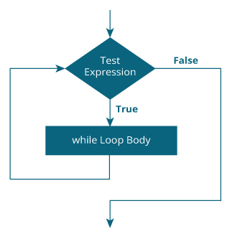
WHILE LOOP
Syntax :
While (Test Expression)
{
// statements inside the body of the loop
}

Slide 5
WHILE LOOP
How While loop works :
The while loop evaluates the test expression inside the parenthesis ().
If the test expression is true, statements inside the body of while loop are executed. Then, the test expression is evaluated again.
The process goes on until the test expression is evaluated to false.
If the test expression is false, the loop terminates (ends).

Slide 6
WHILE LOOP
// Print numbers from 1 to 5
#include <stdio.h>
int main()
{
int i = 1;
while (i <= 5)
{
printf("%d\n", i);
++i;
}
return 0;
}
Here, we have initialized i to 1.
When i is 1, the test expression i <= 5 is true. Hence, the body of the while loop is executed. This prints 1 on the screen and the value of i is increased to 2.
Now, i is 2, the test expression i <= 5 is again true. The body of the while loop is executed again. This prints 2 on the screen and the value of is increased to 3.
This process goes on until i becomes 6. When i is 6, the test expression i<=5 will be false and the loop terminates.
Output :
1
2
3
4
5

Slide 7
DO...WHILE LOOP
The do..while loop is similar to the while loop with one important difference.
The body of do...while loop is executed at least once. Only then, the test expression is evaluated.

Slide 8
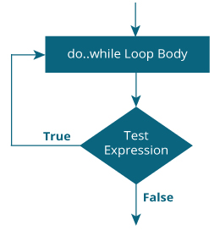
DO...WHILE LOOP
Syntax :
do
{
// statements inside the body of the loop
} while (Test Expression);

Slide 9
DO...WHILE LOOP
How Do...While loop works :
The body of do...while loop is executed once. Only then, the test expression is evaluated.
If the test expression is true, the body of the loop is executed again and the test expression is evaluated.
This process goes on until the test expression becomes false.
If the test expression is false, the loop ends.

Slide 10
DO...WHILE LOOP
// Print numbers from 1 to 5
#include <stdio.h>
int main()
{
int i = 1;
do
{
printf("%d\n", i);
++i;
} while(i <= 5) ;
return 0;
}
Here, we have initialized i to 1.
As we know that do…while loop is executed at least one time, it will be printed when i=1 and then i increments to 2.
Now, i is 2, the test expression i <= 5 is true. The body of the do…while loop is executed again. This prints 2 on the screen and the value of i is increased to 3.
This process goes on until i becomes 6. When i is 6, the test expression i<=5 will be false and the loop terminates.
Output :
1
2
3
4
5

Slide 11
SWITCH STATEMENTS
The switch statement allows us to execute one code block among many alternatives.
You can do the same thing with the if...else..if ladder. However, the syntax of the switch statement is much easier to read and write.

Slide 12
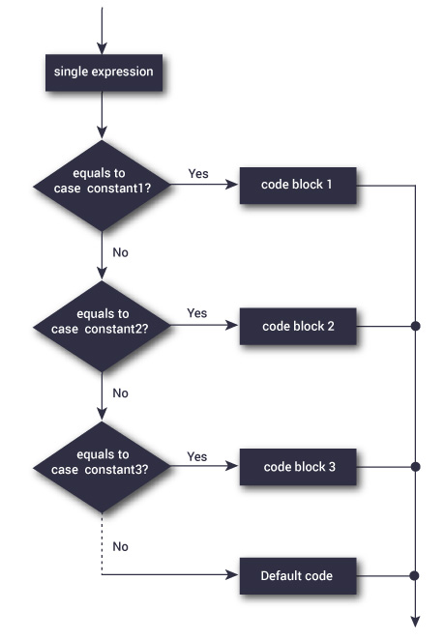
SWITCH STATEMENTS
Syntax :
switch (expression)
​{
case constant1:
// statements
break;
case constant2:
// statements
break;
. . .
default:
// default statements
}

Slide 13
SWITCH STATEMENTS
How switch case works :
The expression is evaluated once and compared with the values of each case label.
If there is a match, the corresponding statements after the matching label are executed. For example, if the value of the expression is equal to constant2, statements after case constant2: are executed until break is encountered.
If there is no match, the default statements are executed.
If we do not use break, all statements after the matching label are executed.
By the way, the default clause inside the switch statement is optional.

Slide 14
// Following is a simple C program to demonstrate syntax of switch.
#include <stdio.h>
int main()
{
int x = 2;
switch (x)
{
case 1:
printf("Choice is 1");
break;
case 2:
printf("Choice is 2");
break;
case 3:
printf("Choice is 3");
break;
default:
printf("Choice other than 1, 2 and 3");
break;
}
return 0;
}
In the given program we have initialized a variable x with value 2.
A switch construct is used to compare the value stored in variable x and execute the block of statements associated with the matched case.
In this program, since the value stored in variable x is two, a switch will execute the case whose case-label is 2. After executing the case, the control will fall out of the switch and program will be terminated with the successful result by printing the value on the output screen.

